Slide 1


Module 4 – Confidence Intervals and Hypothesis Testing
Submitted By:
Anupreeta Mishra
Parinita Mahindrakar
Shivani Adsar

Slide 2
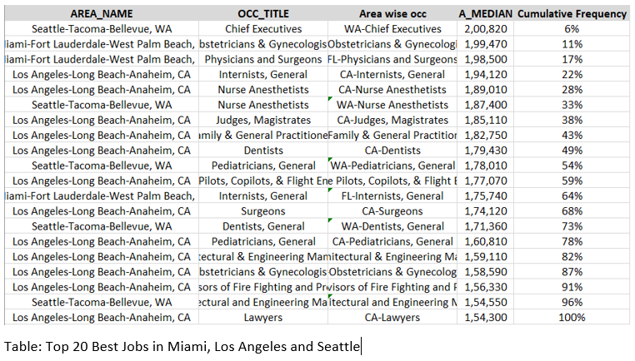
Top 20 Jobs
Median
Gives an accurate representation of the jobs in the three areas
Helps us to find the jobs based on the middle values

Slide 3
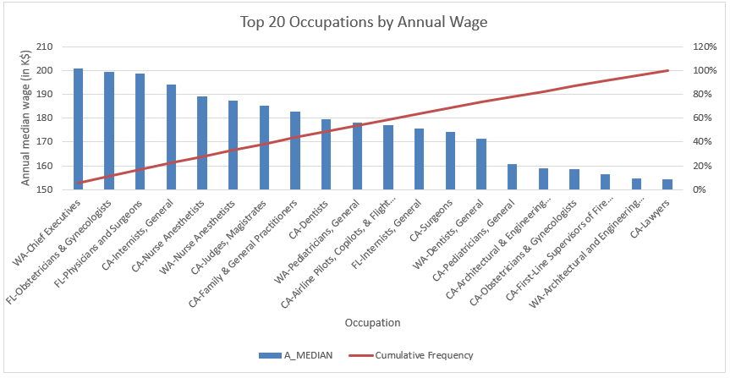
Pareto Chart
Observations:
Shows the top 20 jobs in the descending order by the annual median wage
Chief Executives in Seattle showing highest wage
Lawyers being the lowest in Los Angeles
First 5 occupations contribute to 30% approx. of the total annual wage

Slide 4
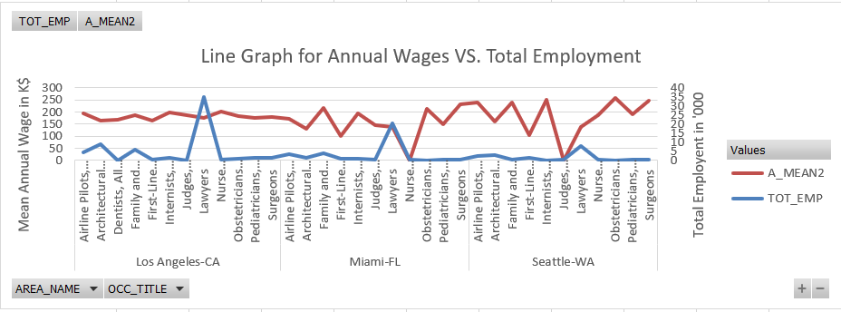
Line Graph
Observations:
Shows the trend between total employment and mean annual wages
Lawyers in Los Angeles are in high demand
Judges in Seattle have the lowest wages

Slide 5
Conclusion
Shows the top 20 jobs in the descending order by the annual median wage
Chief Executives in Seattle showing highest wage
Lawyers being the lowest in Los Angeles
First 5 occupations contribute to 30% approx. of the total annual wage
Shows the trend between total employment and mean annual wages
Lawyers in Los Angeles are in high demand
Judges in Seattle have the lowest wages

